Slide 1
Data Science
Machine-aided multi-document summarization of scientific papers
Student: Andrey Vlasov
Research Advisor: Maxim Panov
Co-Advisor : Konstantin Vorontsov
May, 2020

Slide 2
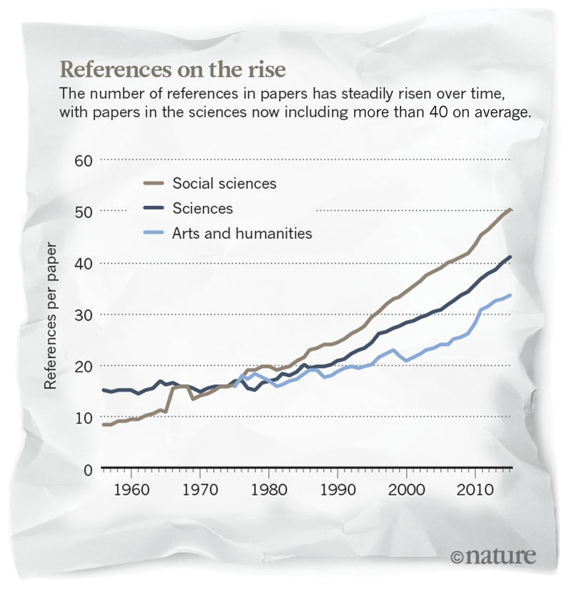
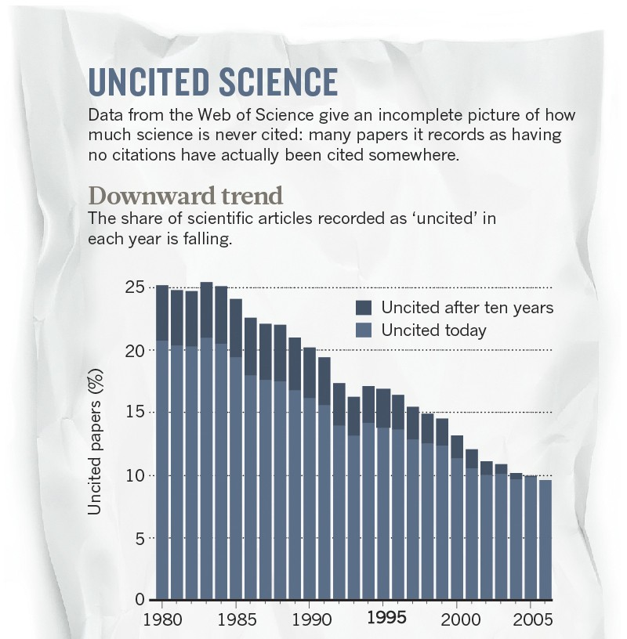
Stating the problem
Notes:
Phrases you may find useful:
The area of my research covers …
Today … has been already studied in the field.

Slide 3
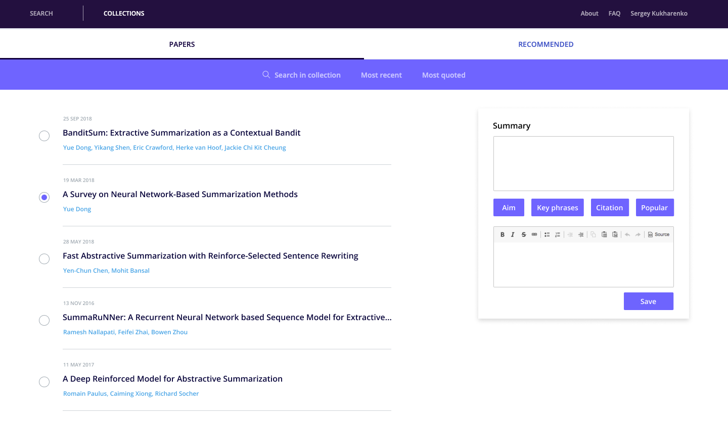
Introduction
Notes:
Phrases you may find useful:
The area of my research covers …
Today … has been already studied in the field.
NB!
In the series of slides ‘General Problem/Introduction/Background’ you are supposed to express motivation of the project (this criterion is going to be evaluated by the Reviewers).

Slide 4
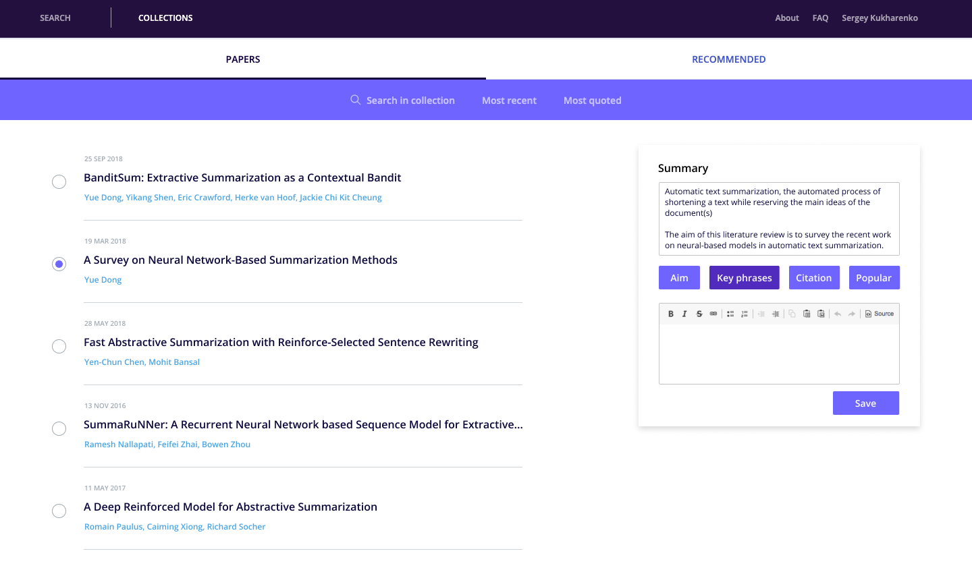
Introduction
Notes:
Phrases you may find useful:
The area of my research covers …
Today … has been already studied in the field.
NB!
In the series of slides ‘General Problem/Introduction/Background’ you are supposed to express motivation of the project (this criterion is going to be evaluated by the Reviewers).

Slide 5
Aim
To create and implement a methodology for solving task of automated multi-document summarization of scientific papers
Objectives
Data collection
Ranking of papers in the collection
Getting phrases from prompters (summarization methods) and their ranking
Evaluation of the summary & quality of the set of prompters (summarization methods)
Notes:
The overall purpose of the work is to …
NB!
On the slide ‘Aim’ you are supposed to express the potential impact of the project (this criterion is going to be evaluated by the Reviewers).
Objectives are the specific or concrete goals to be achieved. They are steps or tasks that needed to be taken to reach the final aim of the project.
The objectives of the present research run as follows:
1…
2…
3…

Slide 6
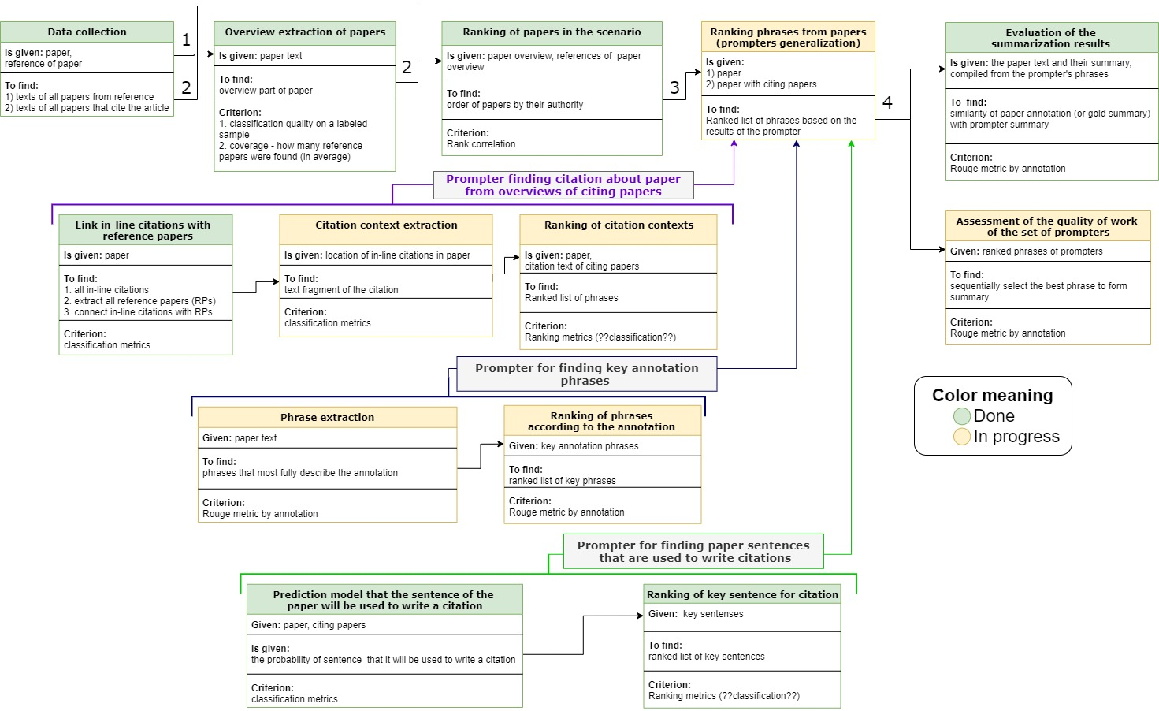
Pipeline
Notes:
NB!
On the slide ‘Objectives’ you are supposed to present novelty of the project in a concise form (this criterion is going to be evaluated by the Reviewers). The topic of the novelty should be presented in greater detail on the slide ‘Algorithms and Methods’.

Slide 7
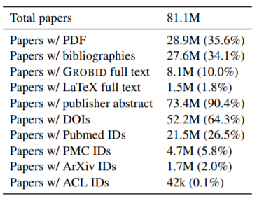
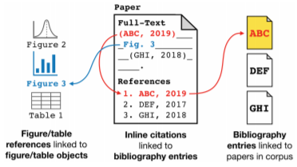
Data collection
S2ORC: The Semantic Scholar Open Research Corpus
Figure 1. Inline citations and references are annotated in full text, bibliography entries, and figure and table captions are preserved; citations are linked to bibliography entries, which are linked to other papers in S2ORC.
Table 1. Statistics of papers in this dataset
Notes:
Presenting the results achieved in the experiment.
Enumerating and describing the theoretical approaches, methods and algorithms used in the research.
Enumerating languages and programs used in the research.
Describing in detail data sets you used.
Presenting the metrics used.
Comparing the results of the experiment with those obtained using other methods.
Outlining the benefits of the used method.
NB!
If you introduce a chart or graph you should explain what it shows. The slide should include the graph/chart, a small bit of text is also allowed.
In addition, your explanations accompanying the graph should be presented orally.

Slide 8
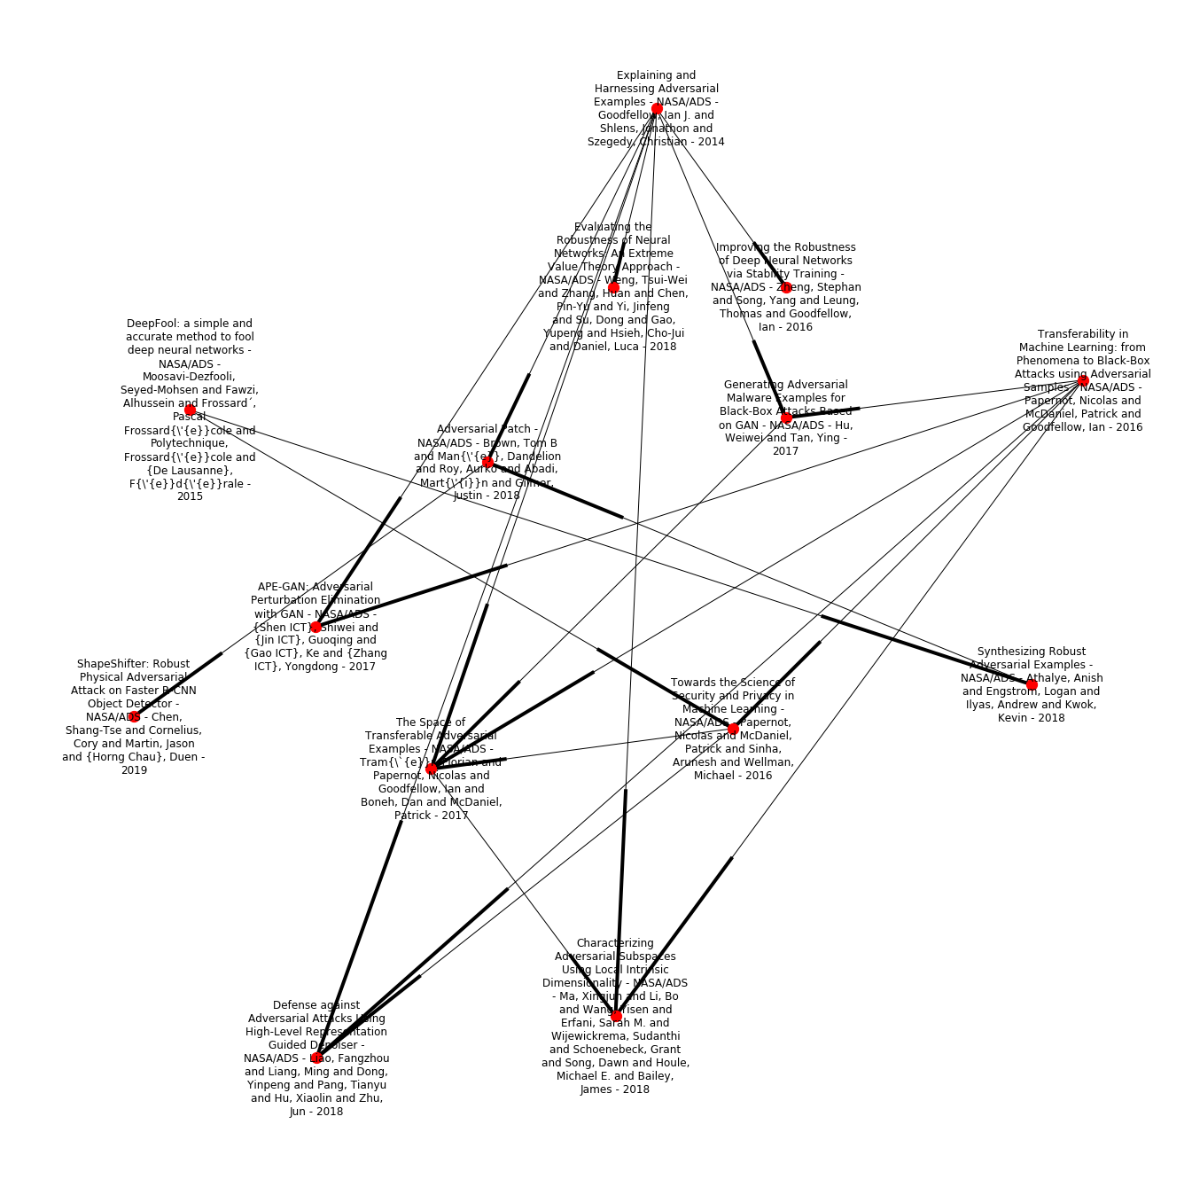
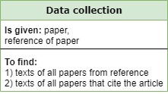
Data collection
S2ORC: The Semantic Scholar Open Research Corpus
Notes:
Presenting the results achieved in the experiment.
Enumerating and describing the theoretical approaches, methods and algorithms used in the research.
Enumerating languages and programs used in the research.
Describing in detail data sets you used.
Presenting the metrics used.
Comparing the results of the experiment with those obtained using other methods.
Outlining the benefits of the used method.
NB!
If you introduce a chart or graph you should explain what it shows. The slide should include the graph/chart, a small bit of text is also allowed.
In addition, your explanations accompanying the graph should be presented orally.

Slide 9
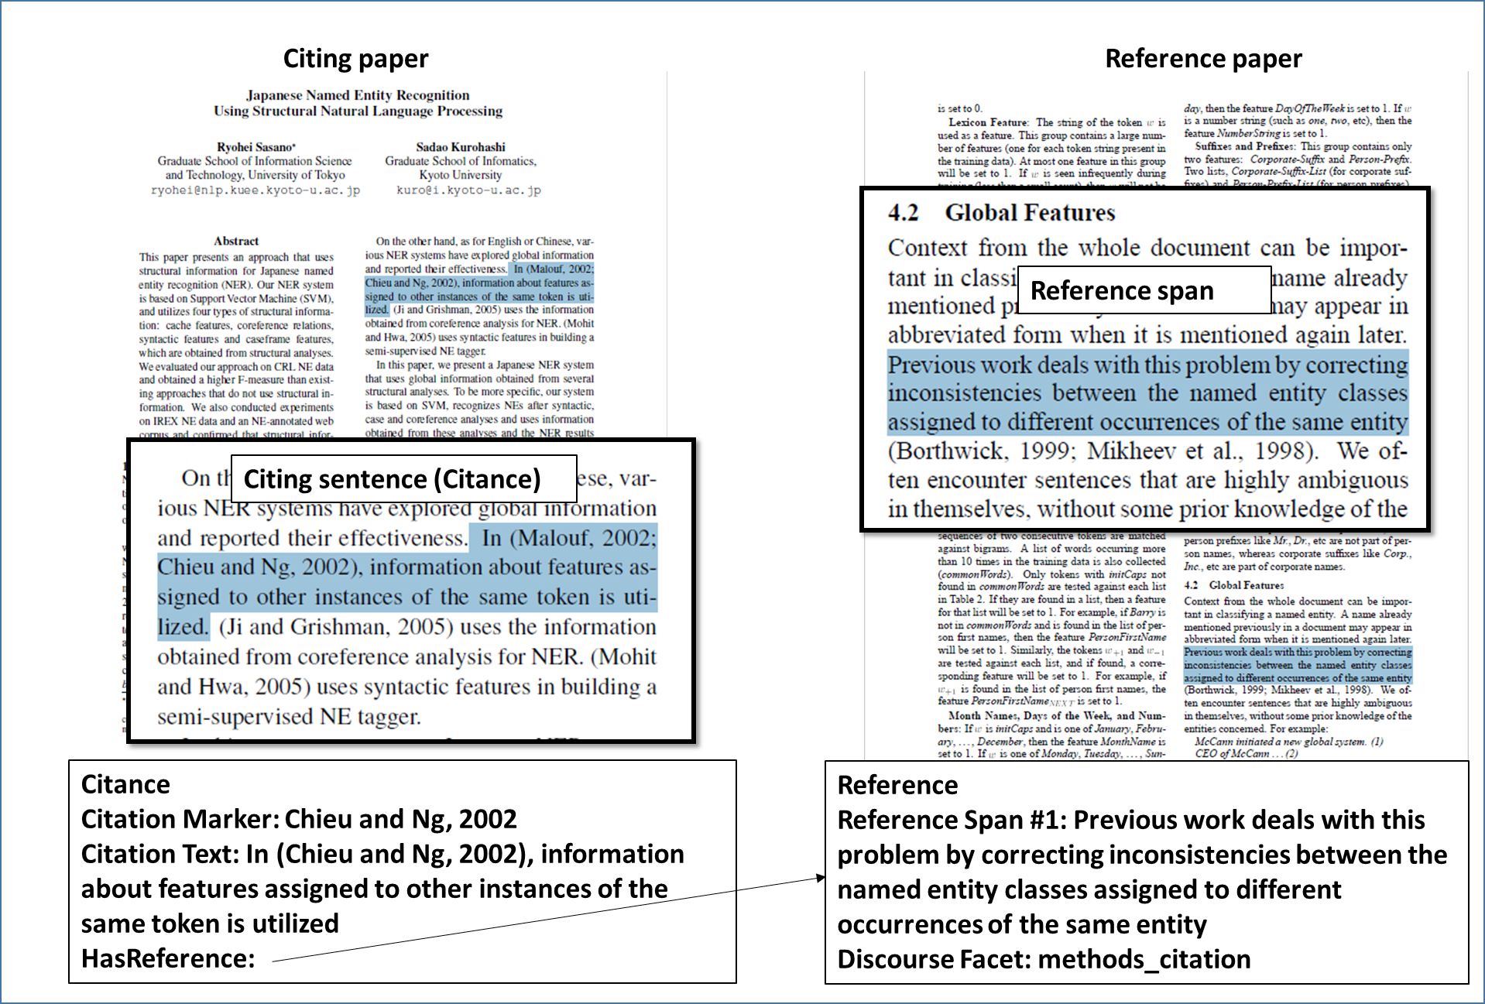
Dataset
CL-SciSumm
Reference span is a sentence in Reference paper which is mostly cited

Slide 10
Dataset
CL-SciSumm
Citance Number: 11 | Reference Article: C00-2123.xml | Citing Article: J04-4002.xml | Citation Marker Offset: ['282'] | Citation Marker: Tillmann and Ney 2000 | Citation Offset: ['282'] | Citation Text: <S sid ="282" ssid = "48">We call this selection of highly probable words observation pruning (Tillmann and Ney 2000).</S> | Reference Offset: ['179'] | Reference Text: <S sid ="179" ssid = "39">For our demonstration system, we typically use the pruning threshold t0 = 5:0 to speed up the search by a factor 5 while allowing for a small degradation in translation accuracy.</S> | Discourse Facet: Method_Citation | Annotator: Swastika Bhattacharya |
Example of 1 annotation with 1 citance of reference paper

Slide 11
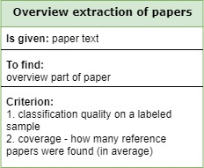
The extraction of an overview part
Rule-based / ML approach on features:
Citation density
The number of consecutive sentences which include at least 1 citation
Positional features
The section position in the paper
An average position of in-line citations in each section
Results:
Accuracy = 82% [Gradient Boosting model]
Accuracy = 61% [Rule-based model]
Coverage = 57% (percentage of papers included in Overview section which have full-text)

Slide 12
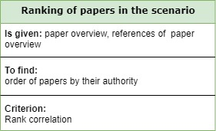
Ranking of papers from the collection
Features:
Year of publication
Paper citation
Сitation of a journal or conference
Presence of identifier (ACL, Pibmed, DOI, arXiv)
Author overlapping
Cosine similar titles of the original paper and its reference paper:
TF-IDF
W2V
LDA
Rouge scores
Topic similarity of Kullback-Leibler divergence between reference paper and other papers from collection

Slide 13
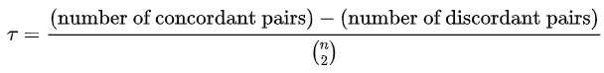
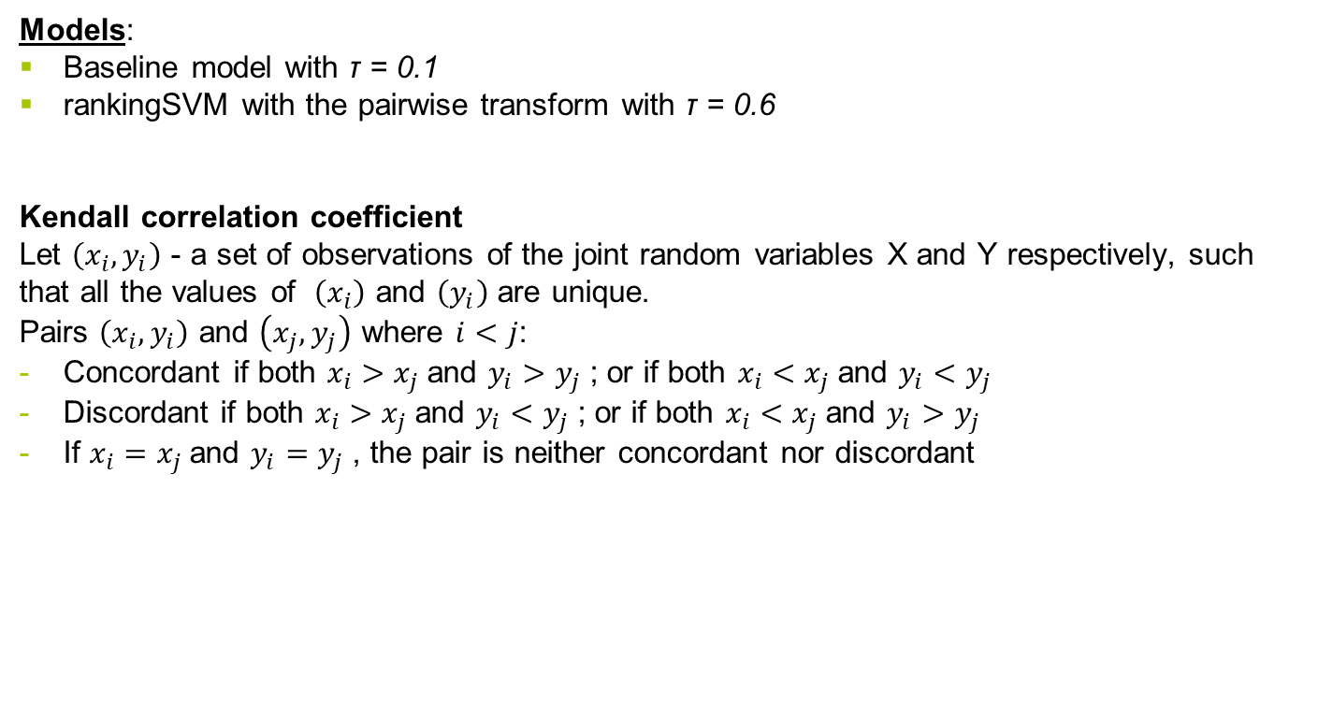
Ranking of papers in the scenario
Models:
Baseline model with τ = 0.1
rankingSVM with the pairwise transform with τ = 0.6
Kendall correlation coefficient
Let $\left(x_{i},y_{i}\right)$ - a set of observations of the joint random variables X and Y respectively, such that all the values of $\left(x_{i}\right)$ and $\left(y_{i}\right)$ are unique.
Pairs $\left(x_{i},y_{i}\right)$ and $\left(x_{j},y_{j}\right)$ where $i<j$:
Concordant if both $x_{i}>x_{j}$and $y_{i}>y_{j}$; or if both $x_{i}<x_{j}$and $y_{i}<y_{j}$
Discordant if both $x_{i}>x_{j}$and $y_{i}<y_{j}$; or if both $x_{i}<x_{j}$and $y_{i}>y_{j}$
If $x_{i}=x_{j}$and $y_{i}=y_{j}$, the pair is neither concordant nor discordant

Slide 14
Citation based summarization
Preprocessing annotated sets of CPs and RPs Jaidka, Overview of the CL-SciSumm 2016 Shared Task, 2016
Computing a set of features:
Features:
> TF-IDF cosine similarity (tfidf)
> latent semantic indexing (lsi) cosine similarity
> number of common bigrams (bigrams)
> positional features
position of the sentence in the RP (sid_pos)
position of the sentence in the section of the RP (ssid_pos)
position of the section in the RP (sect_pos)
Features:
> W2V cosine similarity (w2v)
> Word Mover’s Distance between embedded word vectors (wmd)
> Sequence Matcher (seq)
> Rouge scores
> Latent Dirichlet allocation cosine similarity (lda)
> Hierarchical Dirichlet Process cosine similarity (hdp)

Slide 15
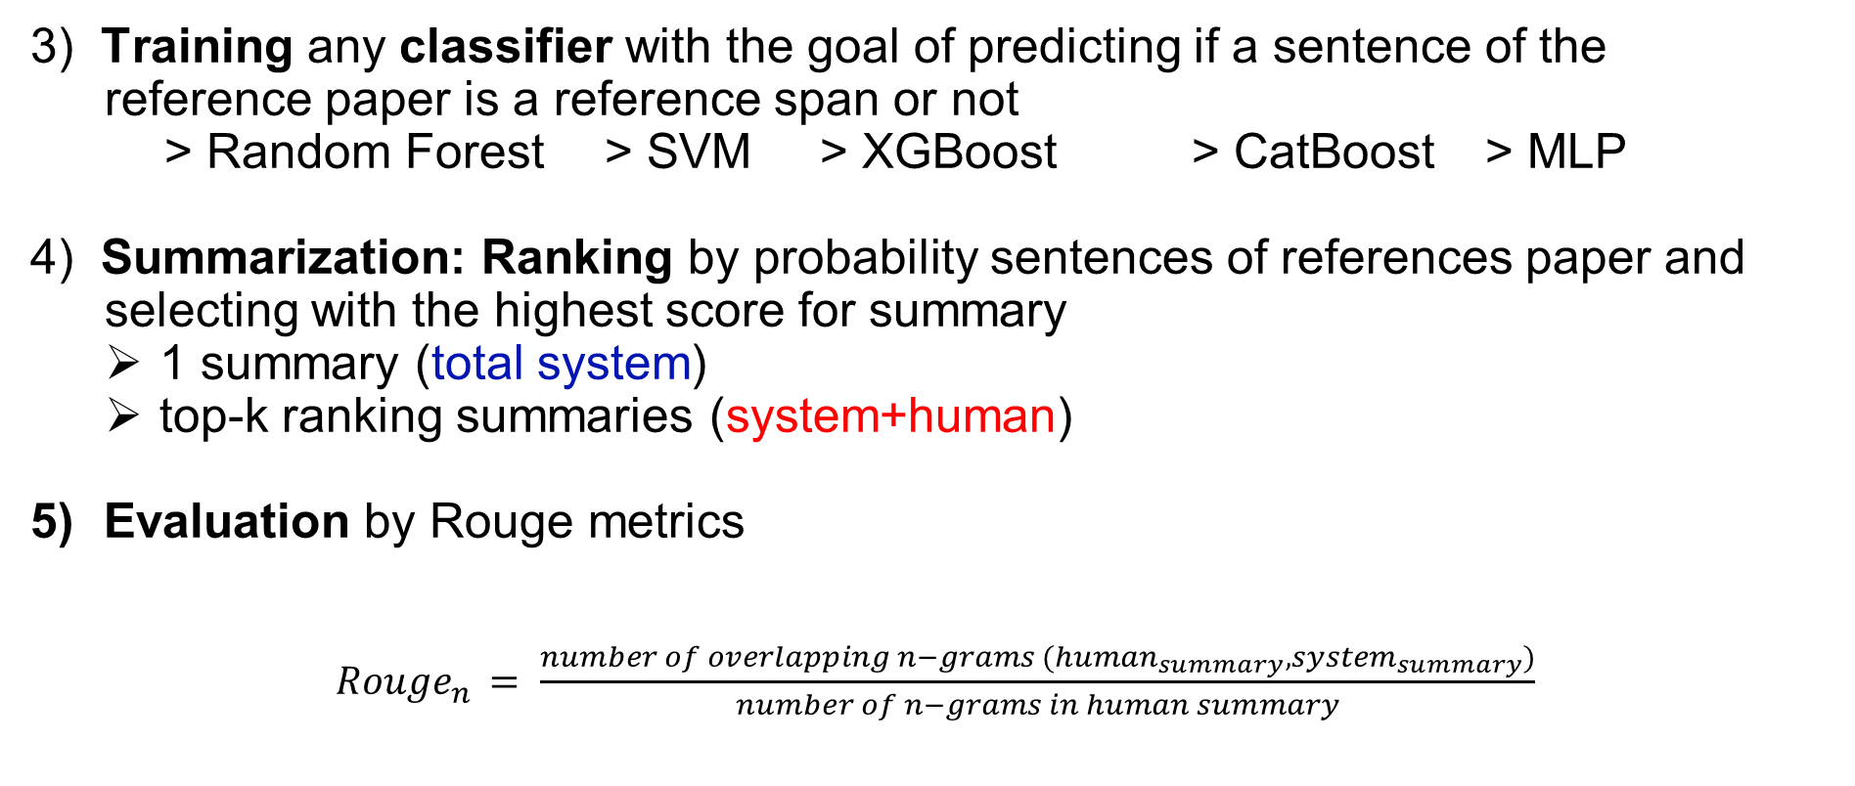
Citation based summarization
Reference span is a sentence in Reference paper which is mostly cited
3) Training any classifier with the goal of predicting if a sentence of the reference paper is a reference span or not
> Random Forest > SVM > XGBoost > CatBoost > MLP
4) Summarization: Ranking by probability sentences of references paper and
selecting with the highest score for summary
1 summary (total system)
top-k ranking summaries (system+human)
Evaluation by Rouge metrics
${Rouge}_{n }= \frac{number of overlapping n−grams ({human}_{summary},{system}_{summary})}{number of n−grams in human summary}$

Slide 16
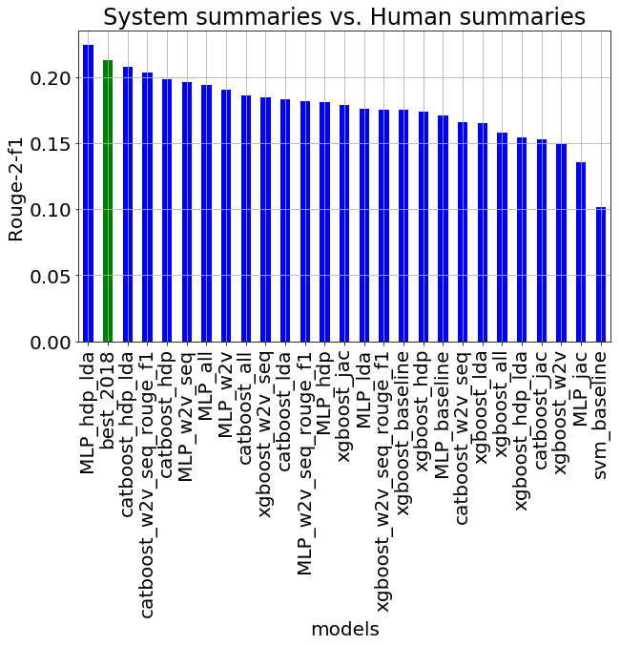
Results for total system summaries
Models made by me
Best model made in 2018

Slide 17
Discussion of results for total system summaries
best features (made by me):
w2v
wmd
lda
seq_match
best models:
multilayer perceptron
catboost
our summarization model works better than the best_2018 model

Slide 18
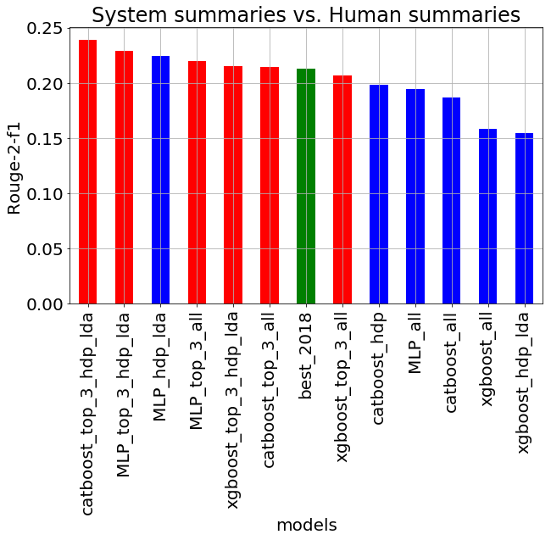
Results for total system & system+human summaries
Models made by me
Models made by me
Best model made in 2018

Slide 19
Discussion of results for system+human summaries
Rouge metric for system+human summaries are 15-19% better than for total system summaries
the best total system classifier == the best system+human classifier

Slide 20
Conclusions
New approach for generating background section was developed
The whole work was made from the beginning to the end (more summarization methods will be realized in the future)
The citation based summarization from reference achieves excellent results.
Notes:
Phrases you may find useful:
All these results suggest that …
We can conclude that …
Taken together, these results point to three conclusions …
To sum up, …
Although it is still too early to draw a definite conclusion, it can be stated that …
Although the obtained data are limited, we may conclude that …

Slide 21
Current Status

Slide 22
Outlook
To improve achieved results
To add new prompters
To implement our solution to https://arxiv-search.mipt.ru/
Notes:
Phrases you may find useful:
The achieved results indicate that the work along the same line should proceed. Thus, the long-term results of the project are to …

Slide 23
Data Science
Machine-aided multi-document summarization of scientific papers
Student: Andrey Vlasov
Research Advisor: Maxim Panov
Co-Advisor : Konstantin Vorontsov
May, 2020

Slide 24
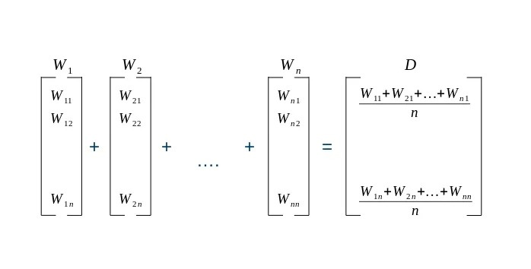
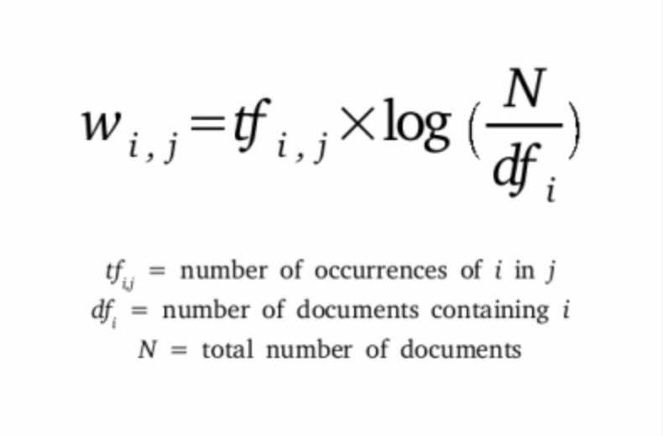
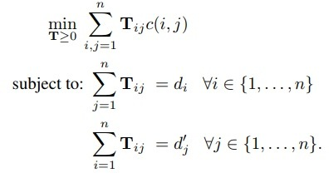
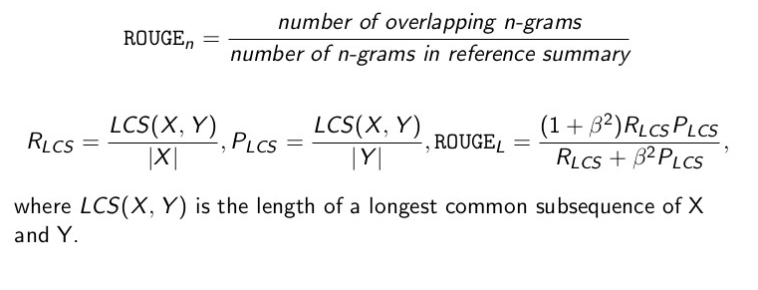
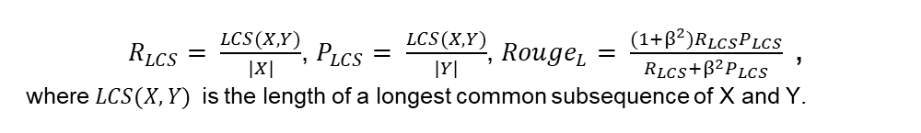
Appendix
$R_{LCS}= \frac{LCS(X,Y)}{|X|}$, $P_{LCS}= \frac{LCS(X,Y)}{|Y|}$, ${Rouge}_{L}= \frac{(1+β^{2})R_{LCS}P_{LCS}}{R_{LCS}+β^{2}P_{LCS}}$ ,
where $LCS(X,Y)$ is the length of a longest common subsequence of X and Y.
> TF-IDF:
> WMD:
w2v embeddings -> normalized bag-of-words (nBOW) to represent the importance -> higher frequency implies that it is more important
> ROUGE:
> SequenceMatcher ratio:
find the longest contiguous matching subsequence (LCS) that contains no “junk” elements
Notes:
Phrases you may find useful:
I would like to express my gratitude to … who <provided smth /assisted in smth/ conducted smth/ etc.>
Thank you for your attention. Now I’m ready to answer your questions.

